Slide 1
Flood System Repair Project (FSRP)
Program Status Briefing
August 28, 2015
Meeting of the Central Valley Flood Protection Board
Dave Wheeldon, Chief
Flood System Sustainability Branch
FMO, Division of Flood Management

Slide 2
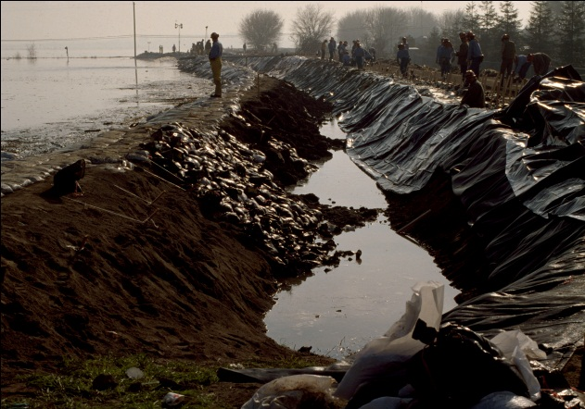
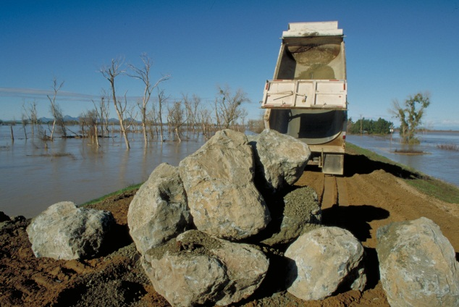
FSRP Summary
Identify and repair documented critical problems of the rural Sacramento and San Joaquin SPFC systems:
  Erosion, boils, slumps, hydraulic control structures, and channels
Repair deteriorated levee patrol roads to ensure effective emergency response capability
Conduct proactive repair of minor levee problems, such as erosion sites shorter than 50 feet
Funded by Prop 1E Bond, projects constructed under a local-State cost share under local direction.

Slide 3
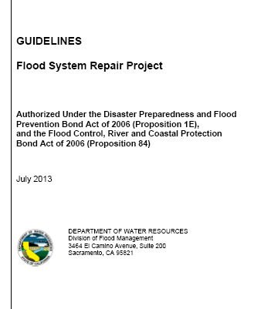
FSRP Program Process
  Guidelines finalized July 2013 (http://www.water.ca.gov/floodmgmt/fmo/fsrp/guidelines.cfm)
  On an annual basis, critical sites are identified and vetted with LMAs by evaluating known past performance levee problems
  Critical sites are prioritized and notices of program eligibility sent to LMAs.
  Project Agreements are developed with participating LMAs
  Design and Construction begins

Slide 4
January 23, 2015 CVFPB Meeting
  Jan 23, 2015 CVFPB Meeting:
    Agreement modified to identify O&M responsibilities for specific project only.
    References to OMRR&R changed to O&M to be consistent with USACE O&M and FSRP Guidelines.
    Resolution 2015-01:
      Adopted form of the agreement,
      Delegated CVFPB EO authority to approve FSRP Agreements
Notes:
Under development means we are working with the LMA to finalize their agreement and get signatures for implementation

Slide 5
FSRP Executed Project Agreements
  8 Executed FSRP Agreements
    Contracts in-place, design and construction activities have begun
    Total State Investment of $14.2 million
    Local Share of approximately $1.2 million
    5 All-Weather Access Road Repair Projects (66 miles)
    2 Critical Erosion Repair and 1 Structure Repair Projects
    8 SERP Sites
Notes:
Under development means we are working with the LMA to finalize their agreement and get signatures for implementation

Slide 6
FSRP Project Agreements in Development
  16 FSRP Agreements in Development
    Letters of Intent to Participate received from LMA
    Formal Agreement development in process:
      Project scope, schedule and total cost development
      Cost-share determination
      Signatures and approvals
    Total Estimated State Investment of $23.8 million
    Local Share of approximately $3.8 million
    11 All-Weather Access Road Repair Projects (63 miles)
    5 Critical Erosion Repair Projects
    Projects to be constructed within the next year
Notes:
Under development means we are working with the LMA to finalize their agreement and get signatures for implementation

Slide 7
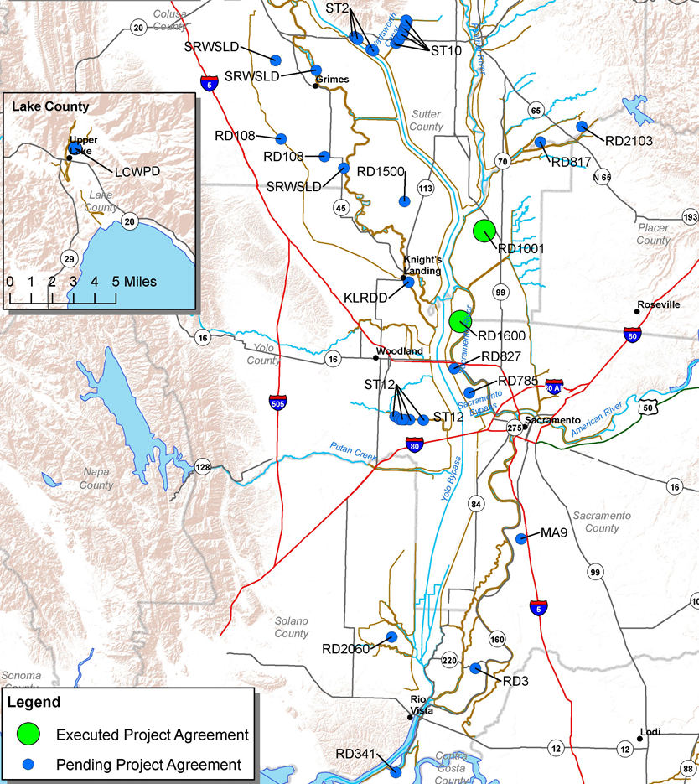
FSRP Projects – San Joaquin River
FSRP Projects – Sacramento River

Slide 8
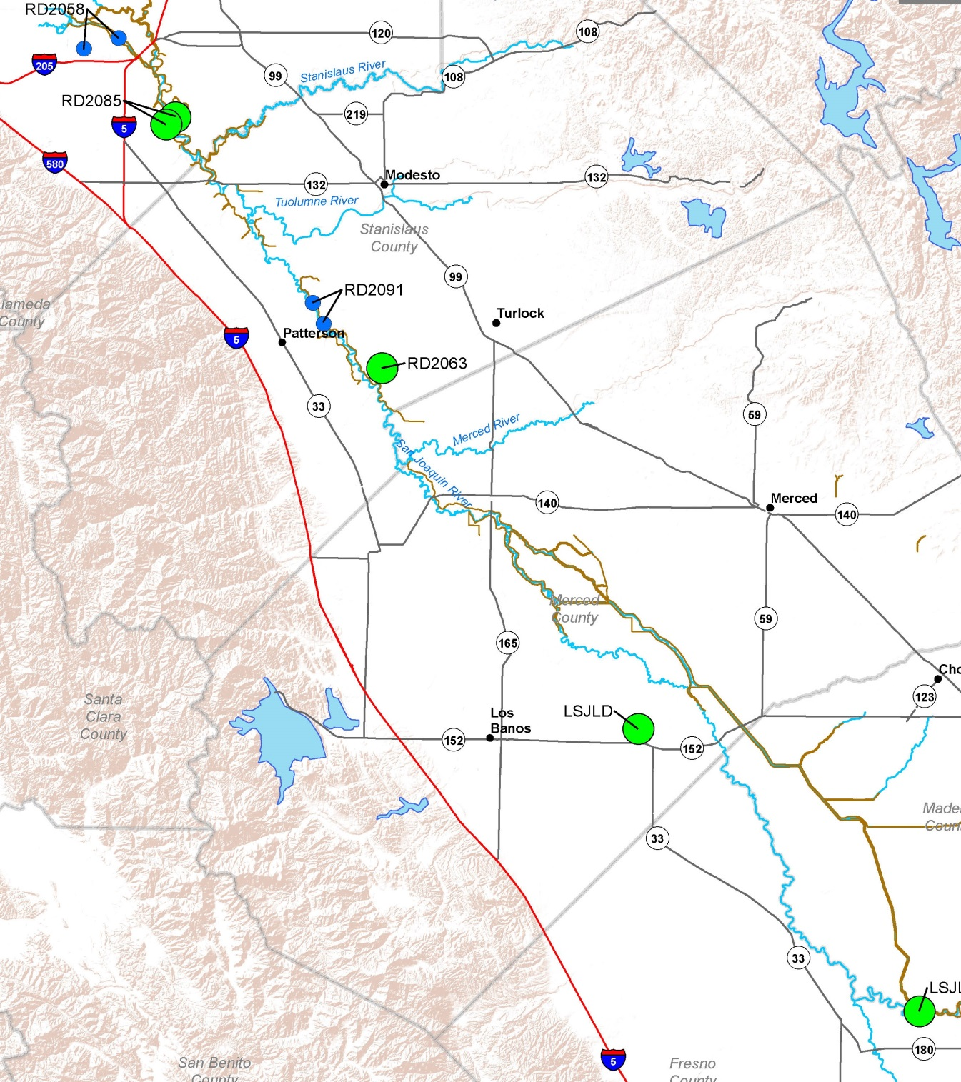
FSRP Projects – San Joaquin River
FSRP Projects – San Joaquin River

Slide 9
FSRP Next Steps
  Complete construction of executed repair agreements
  Finalize FSRP Agreements in development
  Engage with other FSRP-eligible LMAs for agreement and project development
  Continue annual system evaluation and site prioritization
Notes:
Under development means we are working with the LMA to finalize their agreement and get signatures for implementation

Slide 10
Flood System Repair Project (FSRP)
Questions?
David J. W. Wheeldon, Chief
Flood System Sustainability Branch
FMO, Division of Flood Management

Slide 11

FSRP Project Agreement – Board Resolution 2015-01
Now, Therefore, be it resolved:
That the form of Assurance Agreement attached as Exhibit A is approved and adopted.
That the Executive Officer is authorized and directed to execute Assurance Agreements with local maintaining agencies that receive FSRP funding in substantially the form attached hereto as exhibit
That the existing assurance agreements between LSJLD, RD 2085, RD 1600, RD 1001, and RD 2063 for FSRP Funded repairs are hereby ratified, approved, and confirmed.

Slide 12
FSRP Executed Project Agreements
Notes:
Under development means we are working with the LMA to finalize their agreement and get signatures for implementation

Slide 13
FSRP Project Agreements in Development
Notes:
Under development means we are working with the LMA to finalize their agreement and get signatures for implementation

